Slide 1
Introduction to VB Script

Slide 2
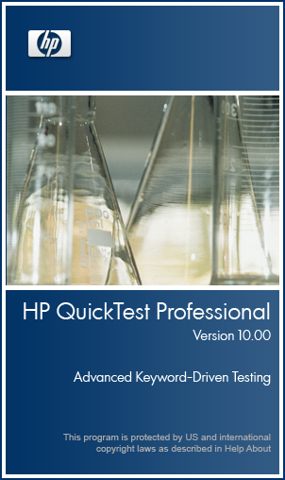


VB Script
VB Script
BASIC
Visual Basic
Visual Basic . Net
VBA
Notes:
VB Script or Visual Basic Script is a light weight scripting language from Microsoft. In the test automation tools, like, QTP, it is used for writing and editing variety of program scripts.
VB Script is part of a family of Microsoft programming languages. This family of products is derived from the BASIC programming language.
Other languages in the family are: Visual Basic, Visual Basic dot Net, VBA – that is Visual Basic for Applications.
VB Script is considered a dialect of VBA.

Slide 3
An Overview of VB Script
VB Script was introduced by Microsoft.
VBScript is used in Automation Testing Tools- QTP/UFT

Slide 4
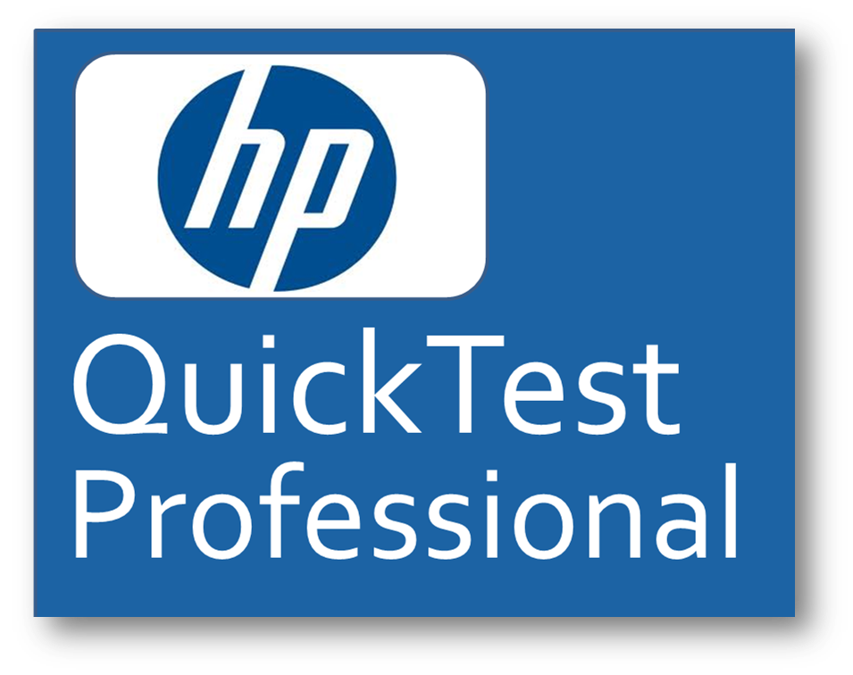

An Overview of VB Script

Slide 5
An Overview of VB Script
VBScript is used as a sub-set in Microsoft Developed languages
1.Basic
2.Visual Basic
3.Visual Basic .Net
4.VBA

Slide 6
For What all We Can Use VB Script in QTP?
In QTP, we can use VB Script for:
Executing Logical Sequences or Routines
Manipulating ActiveX Controls
Performing Simple File Input-Output Operations
Communicating with Database
Communicating with MS-Office Applications, Such as MS-Excel
Notes:
In QTP, we can use VB Script for:
Executing logical sequences or routines,
Manipulating Active X Controls,
Performing simple file input-output operations,
Communicating with database, and
Communicating with MS-Office Applications, such as MS-Excel.

Slide 7

Elements of VB Script
Variables
VB Script
Notes:
Like in any other scripting language, VB Script too provides various elements, helpful in programming.
These elements are: Variables, Constants, Operators, Statements, Functions and Procedures, Standards, and Objects.
Going forward, we will learn about VB Script Variables and Constants.

Slide 8
Elements of VB Script
Variables
Arrays
VB Script
Notes:
Like in any other scripting language, VB Script too provides various elements, helpful in programming.
These elements are: Variables, Constants, Operators, Statements, Functions and Procedures, Standards, and Objects.
Going forward, we will learn about VB Script Variables and Constants.

Slide 9
Elements of VB Script
Variables
dictionary objects
Arrays
VB Script
Operators
Notes:
Like in any other scripting language, VB Script too provides various elements, helpful in programming.
These elements are: Variables, Constants, Operators, Statements, Functions and Procedures, Standards, and Objects.
Going forward, we will learn about VB Script Variables and Constants.

Slide 10
Elements of VB Script
Variables
Arrays
VB Script
Objects
Operators
control flow
Notes:
Like in any other scripting language, VB Script too provides various elements, helpful in programming.
These elements are: Variables, Constants, Operators, Statements, Functions and Procedures, Standards, and Objects.
Going forward, we will learn about VB Script Variables and Constants.

Slide 11
Elements of VB Script
Variables
Arrays
VB Script
Operators
Procedures
control flow
Notes:
Like in any other scripting language, VB Script too provides various elements, helpful in programming.
These elements are: Variables, Constants, Operators, Statements, Functions and Procedures, Standards, and Objects.
Going forward, we will learn about VB Script Variables and Constants.

Slide 12
Elements of VB Script
Variables
Arrays
VB Script
Objects
Operators
Procedures
control flow
Notes:
Like in any other scripting language, VB Script too provides various elements, helpful in programming.
These elements are: Variables, Constants, Operators, Statements, Functions and Procedures, Standards, and Objects.
Going forward, we will learn about VB Script Variables and Constants.

Slide 13
Elements of VB Script
Variables
dictionary objects
Arrays
VB Script
Objects
Operators
Procedures
control flow
Notes:
Like in any other scripting language, VB Script too provides various elements, helpful in programming.
These elements are: Variables, Constants, Operators, Statements, Functions and Procedures, Standards, and Objects.
Going forward, we will learn about VB Script Variables and Constants.

Slide 14
Memory Allocation
Variables: It is a temporary memory allocation to store single value, which can be manipulated during Execution (Runtime)
Constants: It is a temporary memory allocation to store single value, which cannot be manipulated during Execution(Runtime)

